Slide 1
Sales & Orders Performance Dashboard Summary
Business Intelligence Overview
Presented by: Vanshaj Chawla
Date: 5 June 2025

Slide 2
Index
Key Performance Indicators (KPIs)
Sales Analysis by state, Month & Gender
Orders by Channel
Order Status Breakdown
Orders by Age Group and Gender
Filters & Interactive Options
Conclusion & Recommendation

Slide 3
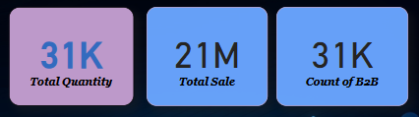
Key Performance Indicators (KPIs)
Key Insights:
Strong sales volume with balanced B2B engagement.
Indicates high transaction volume and business demand.

Slide 4
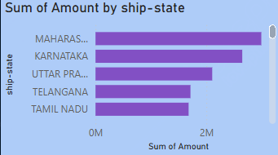
Sales Analysis by State
Top performing states:
Maharashtra
Karnataka
Uttar Pradesh
Telangana
Tamil Nadu
Key Insights:
Maharashtra leads significantly in sales.
Indicates regions with higher market penetration and product demand.

Slide 5
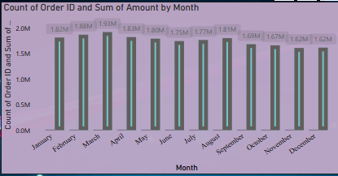
Sales Analysis by Month
Top Sales Months: April (1.88M), May (1.93M), August (1.81M)
Steady sales from February to December range: ~1.62M - 1.82M
Key Insights:
Consistent sales across the year with minor fluctuations.
Peak observed in February and March.
Opportunities to boost year-end sales.

Slide 6
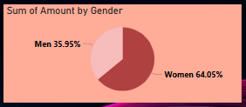
Sales Analysis by Gender
Men: 35.95%
Women: 64.05%
Key Insights:
Women contribute to nearly two-thirds of sales.
Highlights the potential for gender-targeted marketing strategies.

Slide 7
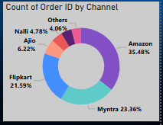
Orders by Channel
Amazon: 35.48%
Flipkart: 21.59%
Myntra: 23.36%
Ajio: 6.22%
Meesho: 4.5%
Nalli: 4.8%
Key Insights:
Amazon leads in order volume.
Flipkart and Myntra also hold strong market share.
Consider optimizing logistics and promotions for Amazon.

Slide 8
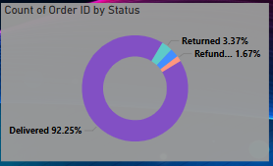
Order Status Breakdown
Delivered: 92.25%
Returned: 3.37%
Refund: 1.67%
Cancelled: 2.72%
Key Insights:
Very high delivery success rate.
Minimal returns, refunds & Cancelled rate indicating customer satisfaction and product reliability.

Slide 9
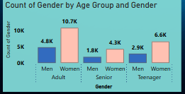
Orders by Age Group and Gender
Women Adult: 10.7K
Men Adult: 4.8K
Others in smaller segments
Key Insights:
Adult women dominate order volumes.
Marketing efforts should focus on this demographic for maximum impact.

Slide 10
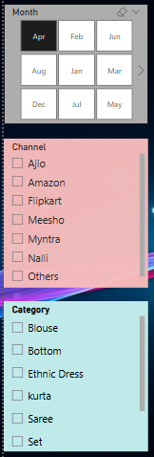
Filters & Interactive Options
Filters available in dashboard:
Month (Jan-Dec)
Channel (Amazon, Flipkart, etc.)
Category (Blouse, Bottom, etc.)
Purpose:
Enables dynamic exploration of data by time, platform, and category.
Supports targeted decision-making and custom reporting.

Slide 11
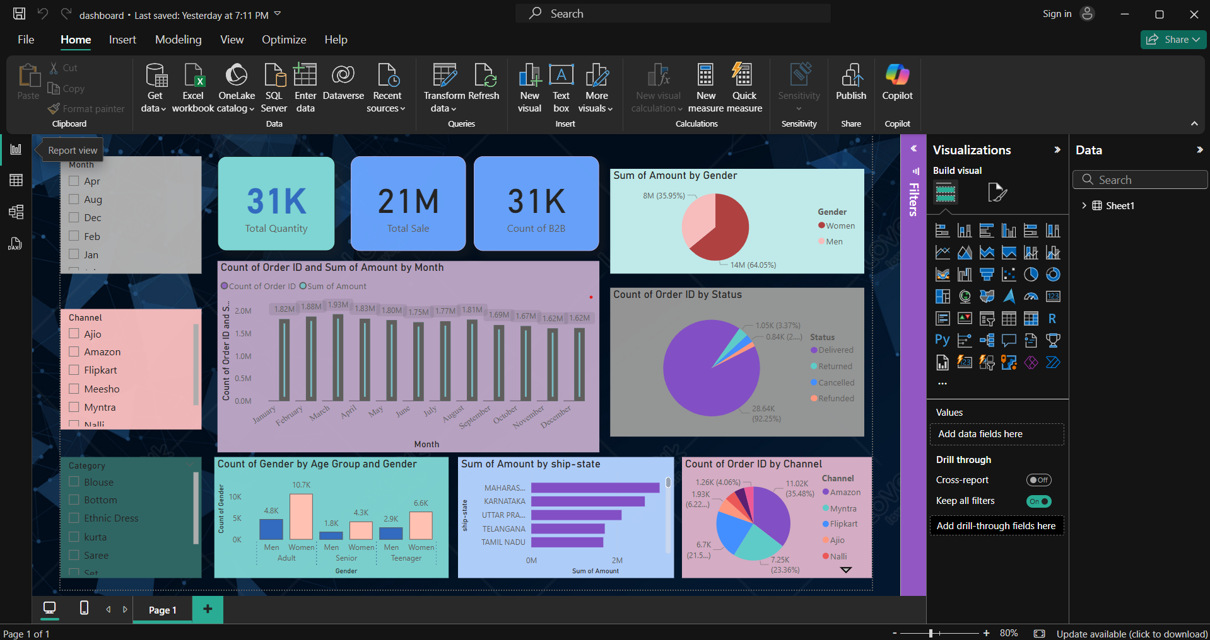
Dashboard

Slide 12
Conclusion
Women constitute the majority of sales.
Amazon is the leading channel.
Maharashtra leads in state-wise sales.
Focus on B2B and top-performing channels for growth.

Slide 13
Recommendations
Strengthen campaigns for women and Amazon users.
Expand in high-performing regions.
Monitor seasonal trends to fine-tune sales strategies.

